Slide 1

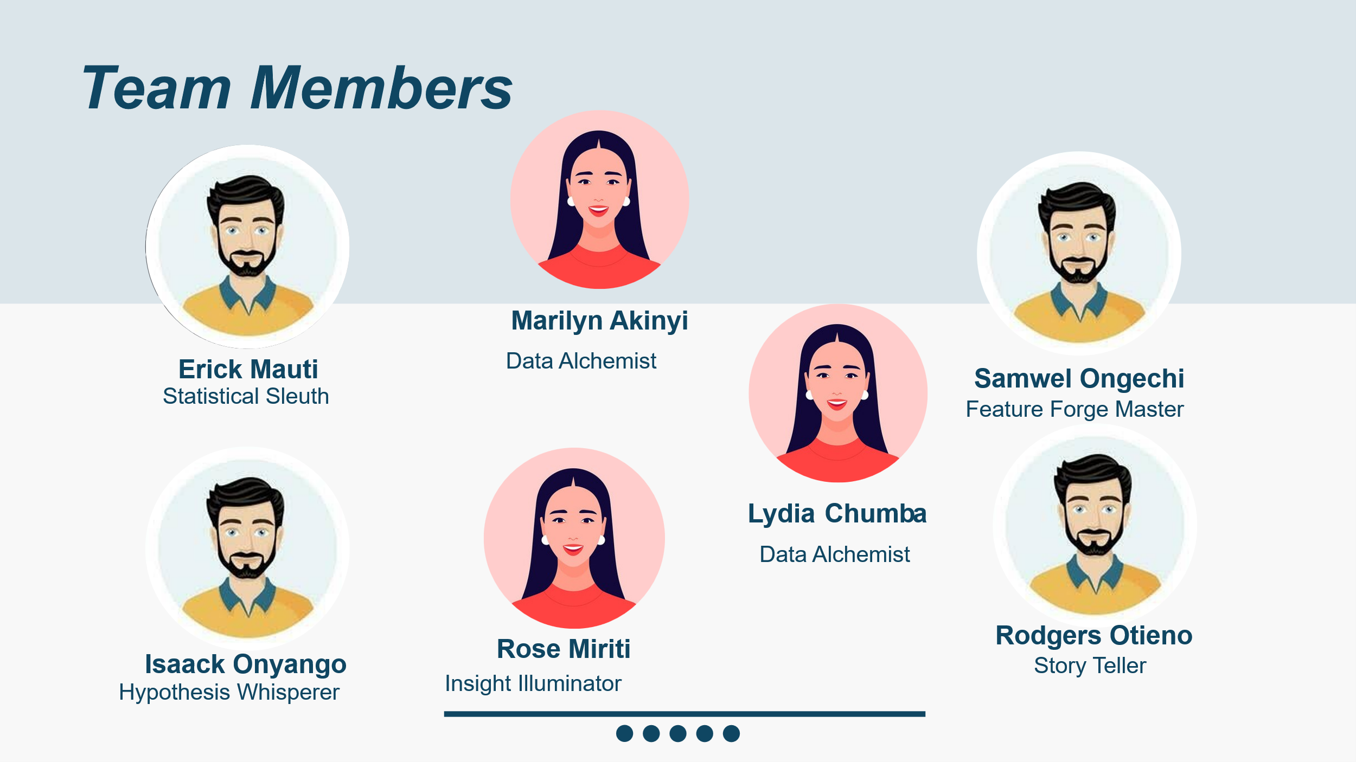
Prepared by group 5
Sentiment Analysis of Tweets on Apple and Google Products September 2025
Technical Mentor: George Kamundia

Slide 2
Introduction
Project Summary & Business Understanding
Business Problem
Core Question
Apple and Google constantly face public scrutiny on social media. Understanding real-time customer sentiment is crucial to improve products, marketing, and customer satisfaction.
"Can we automatically classify the sentiment of tweets about Apple and Google products to support actionable business insights?"
Project Objectives
Determine overall public sentiment towards Apple and Google products
Identify sentiment drivers in tweets
Provide actionable insights for business decisions

Slide 3
Dataset Overview
The dataset contains over 9,093 tweets about Apple and Google products, each labeled with a sentiment.
9,093
3
22
Total Records
Features
Duplicates
Data Columns
tweet_text: The content of the tweet (0.01% missing)
emotion_in_tweet_is_directed_at: Brand/product target (63.8% missing)
is_there_an_emotion_directed_at_a_brand_or_product: Sentiment label

Slide 4
Data Cleaning Process
Stage 1: Initial Cleanup
Stage 2: Handling Missing Values
Renamed columns for easier reference
Imputed missing 'brand' values using product keywords
Dropped 22 duplicate rows
Consolidated sentiment classes into 'Positive', 'Negative', and 'Neutral'
Created lists of Apple and Google product names
Remaining nulls labeled as 'Unknown'
Dropped single row with missing 'text'

Slide 5
Text Preprocessing & Ecosystem Mapping
Text Preprocessing Steps
Converted emojis to text descriptions
Standardized text to lowercase
Removed URLs, mentions, hashtags, and punctuation
Expanded contractions (e.g., "don't" to "do not")
Removed numbers and single letters
Ecosystem Column Creation
Created a new 'ecosystem' column to group brands into either 'Apple' or 'Google' for higher-level analysis by mapping specific product and brand names to their parent company.

Slide 6

Brand Mentions Analysis
66%
5x
85%
More Mentions
Brand vs Product
Ecosystem Gap
Apple has 66% more emotion mentions (3,834) than Google (2,309)
Corporate brands mentioned about 5 times more often than specific products
Apple ecosystem has 85% more emotion mentions than Google ecosystem
Strategic Implications
Apple generates stronger emotional engagement across its ecosystem
Corporate branding drives more emotional discourse than individual products
App experience is a major emotional driver, particularly for Apple (5.8x more mentions)
Opportunity for Google to enhance emotional engagement with its wider product range

Slide 7
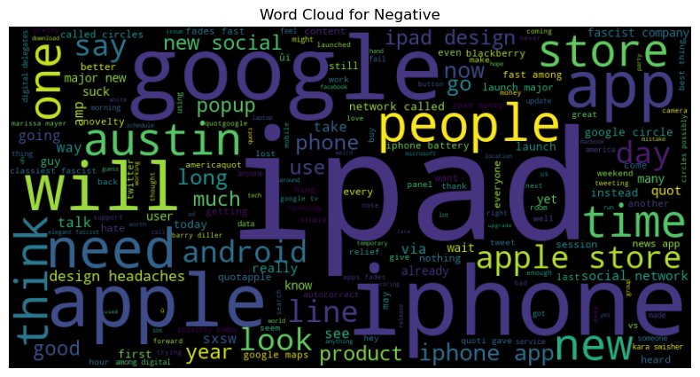
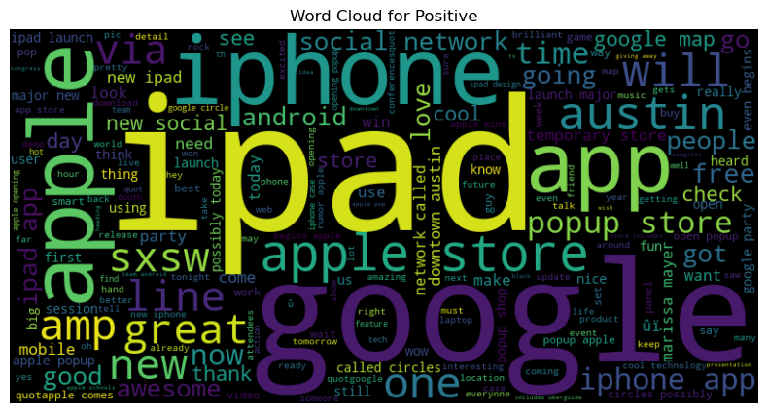
Word Cloud Visualization by Sentiment
Positive Sentiment
Negative Sentiment
Most frequent words: "apple", "google", "store", "app", "ipad", "sxsw", "new"
Most frequent words: "apple", "google", "iphone", "ipad", "app", "store"
Neutral Sentiment
Most frequent words: "apple", "google", "ipad", "sxsw", "iphone", "store", "app", "new", "rt"
This visualization helps identify key terms driving different emotional responses.

Slide 8

Key Findings
1
Sentiment Distribution
The dataset is moderately imbalanced, with a majority of neutral (61%) and positive (32.7%) tweets, while negative tweets represent only 6.3%.
2
Brand Engagement
Apple and its ecosystem generate significantly more emotional engagement on Twitter compared to Google (66% more mentions).
3
Mention Patterns
Corporate brand names are mentioned about 5 times more frequently in emotional tweets than specific product names.

Slide 9
Our Modeling Strategy
Model Training & Evaluation
Handling Class Imbalance
Feature Engineering
Testing various algorithms from simple baselines to complex models. Performance measured using Accuracy, Precision, Recall, and F1-Score.
TF-IDF Vectorization converts tweets into numerical data, capturing word importance relative to the corpus. Maximum 5,000 features to focus on relevant terms.
SMOTE generates synthetic samples for the minority 'Negative' class, creating a balanced dataset and preventing model bias.

Slide 10
Optimizing for Performance
Hyperparameter Tuning Process
Selected Model: Tuned XGBoost Classifier
Method: RandomizedSearchCV with 3-fold cross-validation
Selected for its superior initial performance and ability to handle complex data relationships
Metric: Optimized for weighted F1-score
Target: XGBoost model (our best performer)
Final Model Evaluation: Tuned XGBoost
Sentiment
Precision
Recall
F1-Score
Support
Negative
0.20
0.26
0.23
114
Neutral
0.76
0.77
0.76
993
Positive
0.60
0.56
0.58
529
Overall Accuracy
0.67
1636
The model performs well on Neutral and Positive tweets but struggles with Negative tweets (F1-score: 0.23), likely due to the small number of negative samples in the original data.

Slide 11
Performance Analysis
Strong Neutral Classification
Decent Positive Detection
Negative Sentiment Challenge
The model excels at identifying neutral tweets with 0.76 F1-score, benefiting from the large number of neutral samples (993) in the dataset.
Positive sentiment detection is reasonably effective with 0.58 F1-score across 529 samples.
With only 114 negative samples, the model struggles to accurately identify negative sentiment despite SMOTE balancing.
Overall accuracy and weighted F1-score of 67% indicate a reasonably effective model for three-class sentiment classification on noisy social media data.

Slide 12
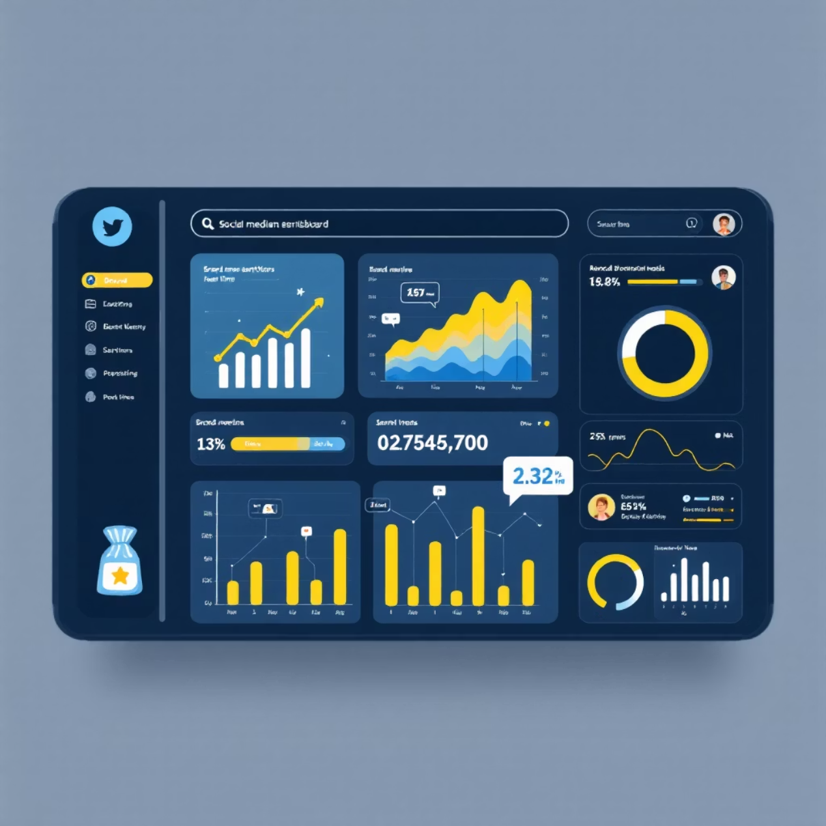
Business Recommendation 1: Monitor Brand Sentiment
Action
Implement this sentiment model to create a real-time dashboard for tracking brand sentiment. Focus on high-level brand mentions ("Apple", "Google"), as these drive the most emotional responses.
Benefit
Quickly identify shifts in public opinion, allowing for proactive brand management and crisis mitigation.

Slide 13
Business Recommendations 2 & 3
Enhance Google Ecosystem Engagement
Address Negative Feedback Drivers
Action: Use the model to flag and analyze negative tweets. Since the model struggles with negative sentiment accuracy, manual review of flagged tweets is crucial.
Action: Google should launch marketing campaigns highlighting the integration and benefits of its entire product ecosystem (Android, Google Apps, Pixel).
Benefit: Apple's ecosystem generates significantly more emotional buzz. Google can close this gap by fostering stronger emotional connections with users.
Benefit: Pinpoint specific customer pain points and direct them to appropriate product teams for resolution, improving satisfaction.

Slide 14

Project Limitations
Class Imbalance
Dynamic Language
Despite using SMOTE, performance on the 'Negative' class remains weak. More negative sentiment data is needed.
The model may struggle with evolving slang, new abbreviations, and changing emoji meanings on social media.
Limited Context
Performance Ceiling
Short tweets (6-11 words) provide little context, making it difficult to capture nuanced sentiment accurately.
Models hit a ceiling around 67-68% accuracy. Advanced techniques like BERT may be necessary to overcome data challenges.

Slide 15
Thank you
Q & A?

